Slide 1
Common Sports Injuries their Immediate Treatment and
Rehabilitation
Dr. Vivek B. Sathe
Senior Assistant Professor,
School of Physical Education,
Devi Ahilya University, Indore

Slide 2
Presentation Blueprint
Introduction of Sports Injuries
  How do sports injury occur
  Causes and Prevention of Sports Injuries
  Common injuries
Immediate Treatment of Injuries
Cold and Heat Application
Rehabilitation
Conclusion and clarification of queries

Slide 3
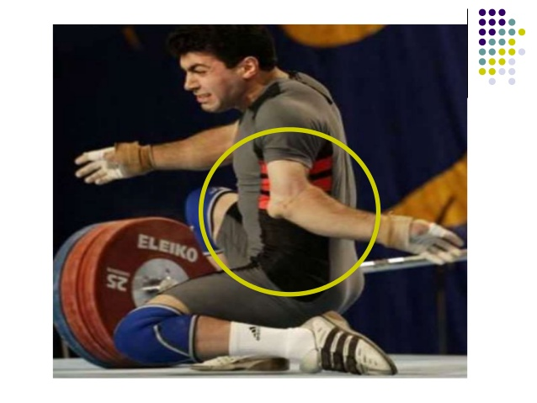
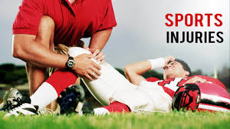
Sports Injuries
Sports injuries refer to the kinds of injury that
occur during sports or exercise. While it is possible
to injure any part of the body when playing sports.
The term sports injuries is commonly used to
refer to injuries of the musculoskeletal system.

Slide 4
Introduction of Sports Injuries
How do Sports Injuries occur?
Injuries may occur during play or during your daily activities, it happen in three distinctive ways.
They can be the result of:
External Violence
Internal Violence
Over-use

Slide 5
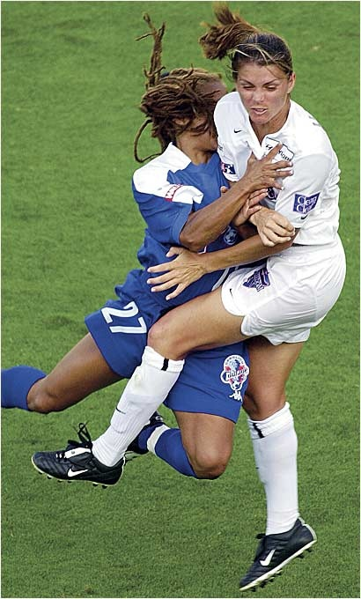
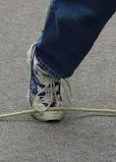
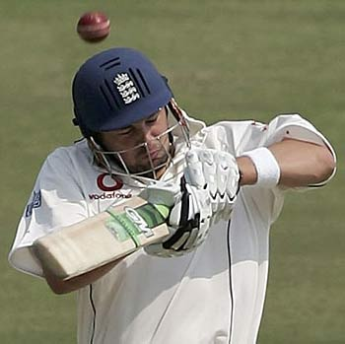
Introduction Cont…
External Violence
Injuries, that are the result of the body coming into contact with something external to the performer.
This can be physical contact with another player
Being hit by equipment or implements. Coming into contact with the ground or other parts of the field of play.

Slide 6
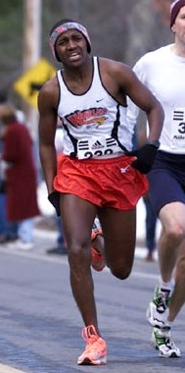
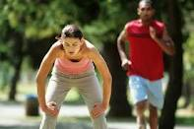

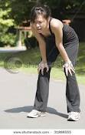
Introduction Cont…
Internal Violence
This is when a part of the performer’s body fails to cope with the stress placed upon it.
Over-use Injuries
When one part of the body is used over and over again.
This places strain on the body part.
Repetitive strain.
Ex.– Running on hard surface.

Slide 7
Causes of Sports Injuries
Factors predisposing the Sports Injuries-
Insufficient Warming up
Improper Cooling Down
Use of improper Equipment
Faulty Technique / Skill
Lack of Physical Fitness

Slide 8
Causes of Sports Injuries
Factors predisposing the Sports Injuries-
Over Training
Improper Rest and Recovery
Knowledge of rules
Muscular imbalance
Clothing and Playing surface

Slide 9
Sports Injuries Cont…
Some Most Common Injuries
Skin Injuries - Abrasion
Laceration
Muscle Injuries - Contusion (Bruise)
Strain
Cramp
Ligament Injury - Sprain
Bone & Joint Injuries - Fracture
Dislocation

Slide 10
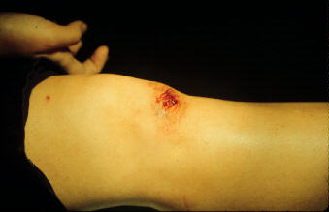
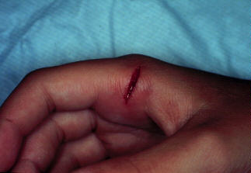
Skin Injuries
Abrasion –
The skin is scrapped on account of friction or fall especially over the areas where the bone is very close to the skin.
Laceration –
It is the irregular tear of the skin and other superficial structures

Slide 11
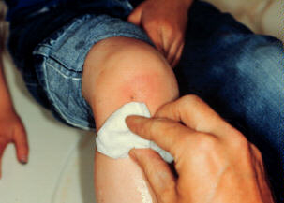
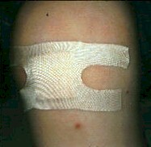
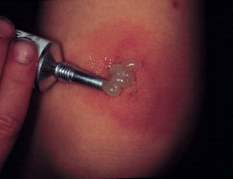
Skin Injuries Cont…..
Immediate treatment
1. Cleaned with antiseptic lotion.
2. Covered with sterile dressing, but air should reach the wound.
3. Antitetanus injection is recommended.
4. After some time apply ointment on open wound and take part in activities carefully.

Slide 12
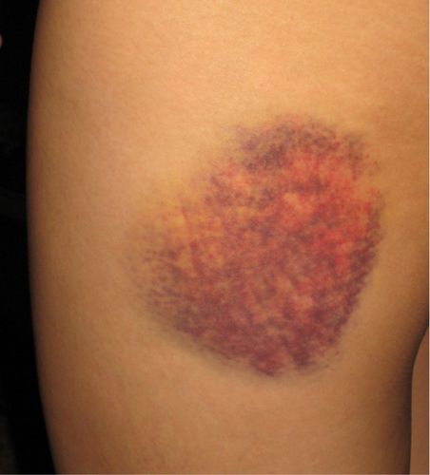
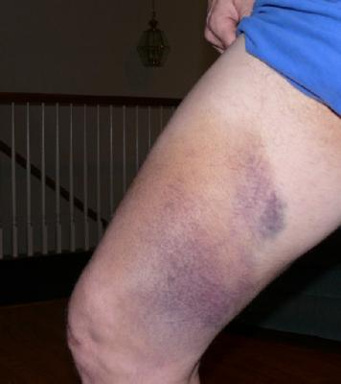
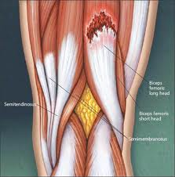
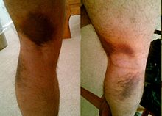
Muscle Injuries
Contusion (Bruise)–
Severe blow to the muscle can lead to contusion.
The blood vessels in the muscle are ruptured and collection of blood under the thin layer of skin.
Strain –
  An injury to a muscle that occurs when the muscle is stretched beyond its normal range of motion, causing the muscle to tear.

Slide 13
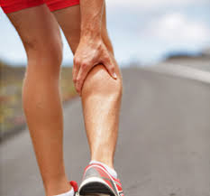
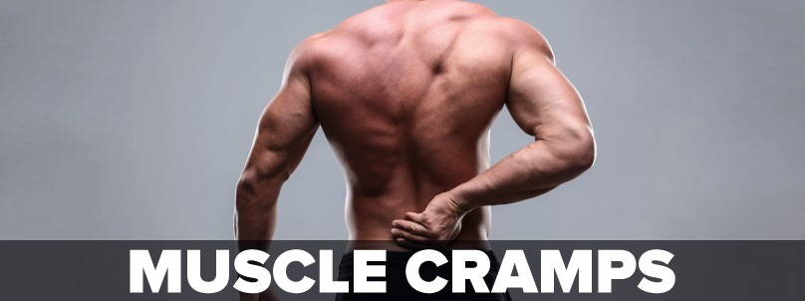
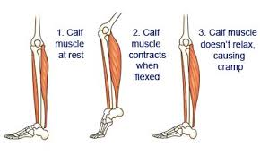
Muscle Injuries
Cramp–
A muscle cramp is a sudden and involuntary contraction of one or more of your muscles.
Long periods of exercise or physical labor, particularly in hot weather, can lead to muscle cramps.
Some medications and certain medical conditions also may cause muscle cramps.
You usually can treat muscle cramps at home with self-care measures.

Slide 14
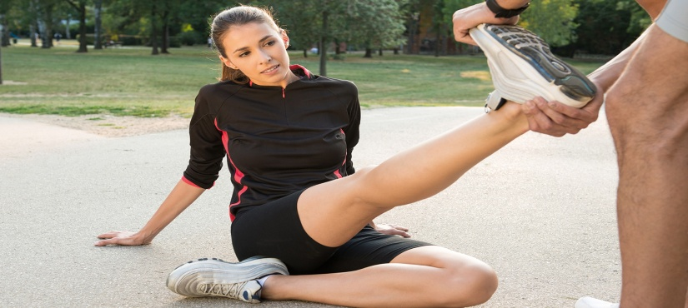
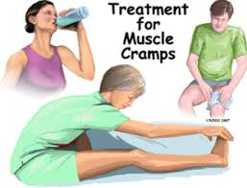
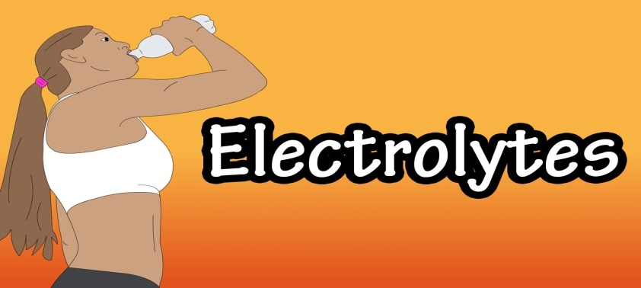
Muscle Cramp immediate Treatment
Cramp–
Stretching, massage and drinking plenty of liquids, such as water, may be helpful in treating simple muscle cramps.
With exceptional heat cramps due to electrolyte abnormalities, appropriate fluids and sufficient salt improves symptoms.

Slide 15
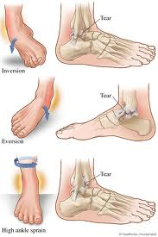
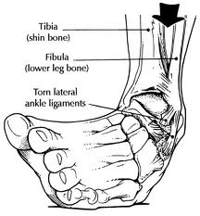
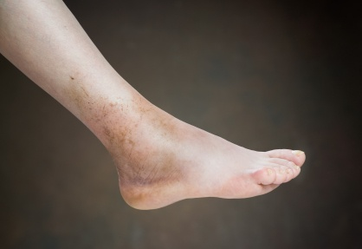
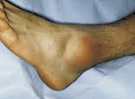
Ligament Injury
Sprain –
  An injury in which ligaments (attach bones to bones and keep a joint together) are stretched and partially or completely torn caused by twisting motions that muscles can’t control

Slide 16
Muscle and Ligament Injury
Immediate treatment
Whenever there is any injury to bones, joints, ligaments muscles or tendons, blood vessels will be damaged.
Broken blood vessels mean that blood leaks into tissues
around the injury. This will lead to swelling and pain.
To combat the effects of this, follow the method of treatment:
P+R I C E

Slide 17
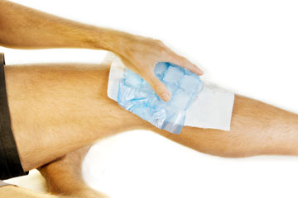
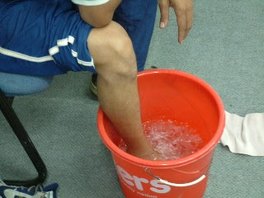
Muscle and Ligament Injuries Cont…
Protection-
Protection of the original injury from additional trauma.
Rest— 2-3 days with immobilization
Ice Application—
Cold relieves pain and prevents or reduces swelling and inflammation. Immediately put cold packs, crushed ice, or cold towels on the injured area, or immerse it in ice water for 20 to 30 minutes at a time every 2 hours.

Slide 18
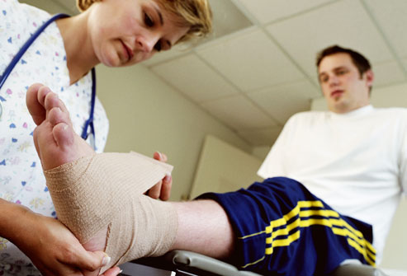
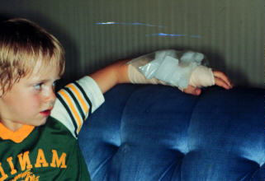
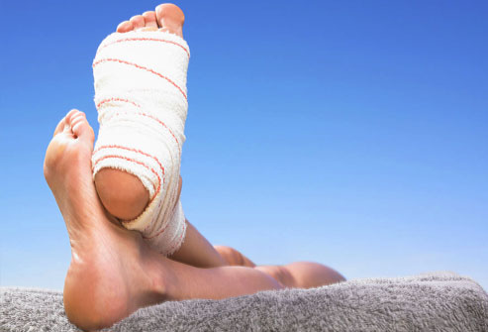
Muscle and Ligament Injuries Cont…
Compression—
To limit internal bleeding from the injury site, wrap a compression bandage (usually an elastic one) in an overlapping spiral that supports the entire injured area.
Elevation—
Decreases swelling by encouraging blood to return to the heart, limits circulation, reduces swelling

Slide 19
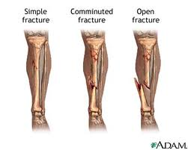
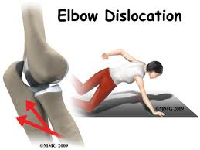
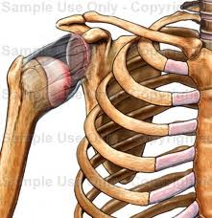
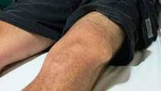
Bone and Joint Injuries
Fracture-
A bone fracture is a medical condition in which there is a break in the continuity of the bone. A bone fracture can be the result of high force impact or stress repetitive activity and muscle forces acting across the bone.
Joint Dislocation-
Occurs when bones in a joint become displaced.
It is often caused by a sudden impact to the joint. The ligaments always become damaged as a result of a dislocation.

Slide 20
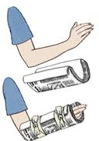
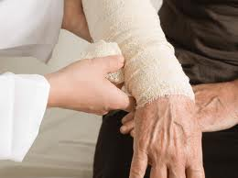
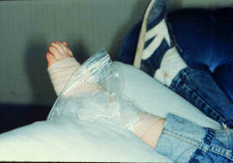
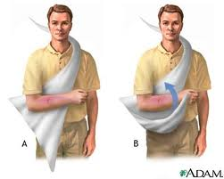
Bone and Joint Injuries Cont…
Immediate treatment
1. In case there is any bleeding then treat it first. Flush open wounds associated with compound fractures with clean, fresh water and cover them with a dry dressing.
2. Do not try to move the broken limb or part as it can worsen the fracture or Never try to push back the dislocated bone forcefully.
3. Apply a cold pack to the area of fracture or dislocation to decrease swelling and to relieve pain.
4. Support a broken limb or dislocated part by using the best material available for a splint, such as sticks, part of a backpack frame, or other stabilizing device.
5. Consult a doctor immediately.

Slide 21
Cold and Heat Application
Cold Application
When to use cold
Acute and severe injuries – from the moment of the injuring up to 3 days after
Sprains, strains and bruises
Repetitive use conditions/Overuse injuries
During exercise in hot environment - cool down with fans, ice packs and cold towels

Slide 22
Cold Application Cont…
What does cold do?
When applied locally (to affected area) it reduces the temperature of the skin, then the muscles and joints
Effect may last up to 45 minutes after cold source is removed
Restricts blood flow to the area by narrowing the blood vessels (vasoconstriction)
Decrease inflammation, swelling and muscle spasm
Reduces bleeding
Decreases pain

Slide 23
Cold and Heat Application
Heat Application
When to use Heat
With chronic injuries - two weeks or more and have persisted for a length of time
For relaxation (baths)
Before deep stretching
Before exercise to warm the muscles

Slide 24
Heat Application Cont…
What does Heat do?
When applied to affected area it increases the temperature of the skin and muscle tissue
Effect may persist for up to 1 hour after the source is removed
Blood vessels open-up (dilate) and increases blood flow to tissues below heat source
Increased local cellular activity (metabolism) and sweat production
Reduces stiffness, tissues become more flexible

Slide 25
Rehabilitation
The combined and coordinated use of medical, social, psychological and vocational measures for training and retraining the individuals to the highest possible level of functional ability.

Slide 26
Rehabilitation
Rehabilitation Principle for Sports Injuries
Diagnosis of Injuries
Grading of Injuries
Management of Injuries

Slide 27
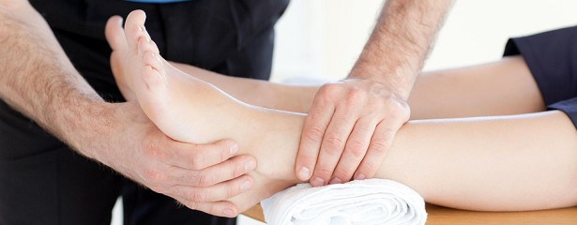
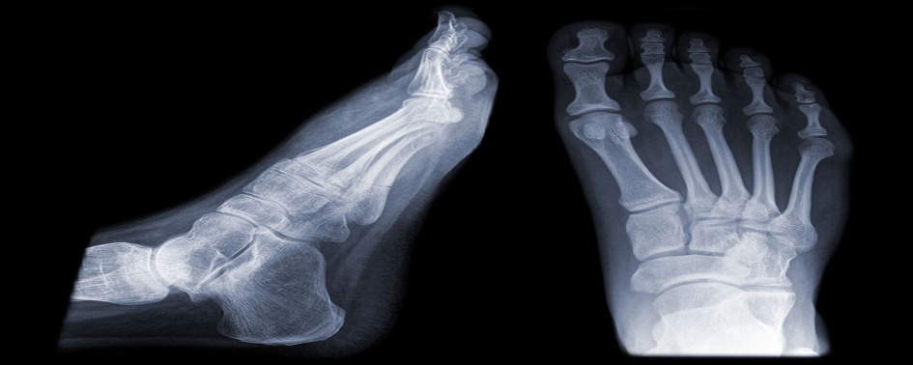
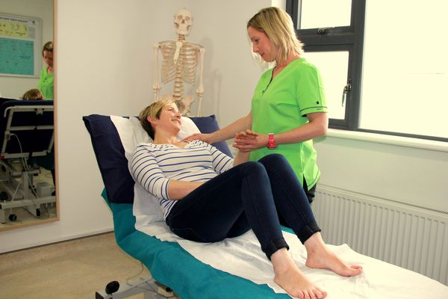
Rehabilitation Cont…
Diagnosis of injuries –
By the use of proper physical examination.
Conducting required investigations.
Finding out any previous history of injuries.

Slide 28
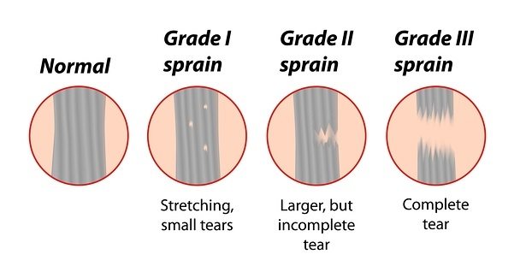
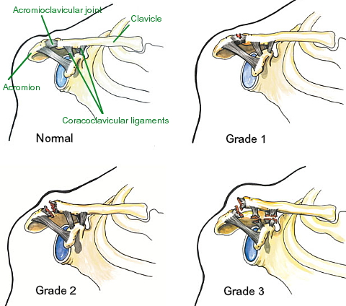
Rehabilitation Cont…
Grading of injuries –
Involves assessing the level of disability (Based on Symptoms)
Previous state of fitness or ability to return to normal activity
Role in the sports and his / her mental toughness

Slide 29
Rehabilitation Cont…
Management of injuries –
Immediate management.
Progressive active & early mobilization.
Passive physical treatment.
Drug therapy.
Psychological treatment.
Biomechanical techniques and devises.
Specialist opinion.

Slide 30

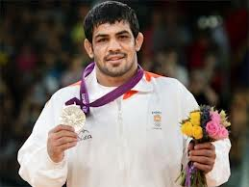
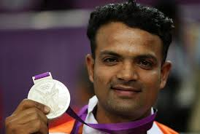
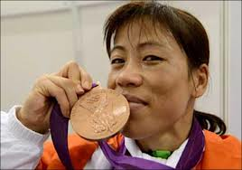
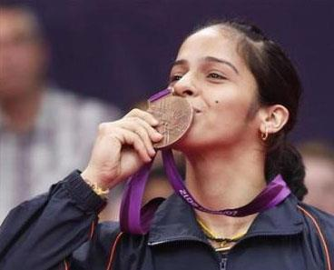
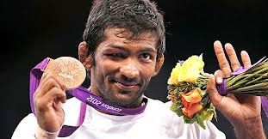

Thanks

